Slide 1

Interfaces In Java Discussion & Lecture Eric Pogue
Agenda for Wednesday, February 26th at 11am CT:
Introductions
Interfaces In Java Preview
Object-Oriented Programming
Interfaces in Java
Interfaces in Other Languages
Questions & Answers
Discussion & Questions welcome at any time… please be present with no phones or email during our time together

Slide 2
Friendly Conversation Topic “Most developers know JavaScript — and want to know Go”
Notes:
https://www.infoworld.com/article/3519613/most-developers-know-javascript-and-want-to-know-go.html

Slide 3
Go
Go is the programming language developers most wanted to learn, for the third year running.
Notes:
HackerRank

Slide 4
Interested in Learning More?
Notes:
HackerRank

Slide 5

Interested in Learning More?
Notes:
HackerRank

Slide 6
Safari Books Online & Lewis University
Notes:
HackerRank

Slide 7
Introductions

Slide 8
Introductions
Name:
Eric Pogue
Background:
Married with five children, recently relocated from Davenport, IA to Chicago area
Undergraduate in CS and Masters in Business… teaching part-time for many years
Experience:
Decades in the industry as a developer, architect, project manager, division manager, and vice president of various software development organizations.
Part of many teams that have delivered products to tens of millions of customers globally
Parsons Technology, Intuit, The Learning Company, Jasc Software, and John Deere
… and most recently working on a startup product “Stadia” with my oldest son

Slide 9
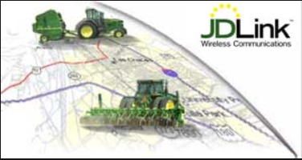

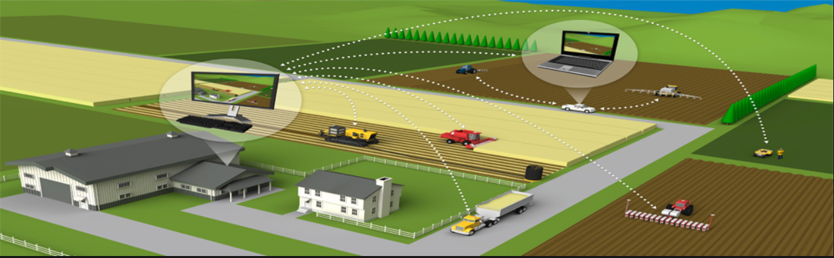



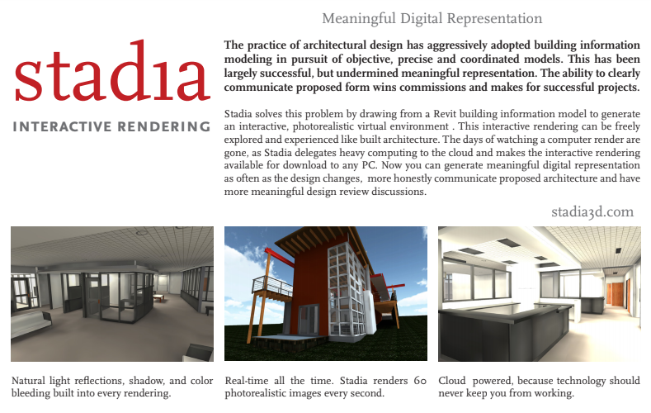

Slide 10
Cyber Security?
Notes:
Programming Background
Java
Object-Oriented Programming
Encapsulation
Inheritance
Polymorphism

Slide 11
Interfaces In Java

Slide 12
Object-Oriented Programming

Slide 13
Object-Oriented Programming Language History
Simula late 1960s
Smalltalk early 1970s
Object Lisp late 1970s
Object Pascal mid 1980s
C++ and Eiffel late 1980s
Java and Python 1990s
C# 2000s
Go, Dart, TypeScript, Swift 2010s

Slide 14
Language Popularity

Slide 15
Classes
Object-oriented programming is a programming model based on Classes which contain both Properties (member variables) and Methods (member functions) that operate on that those Properties.
Shape
Circle
Rectangle
Square
Notes:
I will often start with definitions from Wikipedia and other sources. If you are struggling with a topic and/or would like more information, it can often be valuable to review the references. You should be able to click on the [link] tag (possibly while holding the shift key down) in order open the reference in a browser.
Properties are the same as Attributes or member variables
Methods are the same a member functions

Slide 16
Classes & Objects
Most popular OOP languages are class-based, meaning that Objects are instances of Classes.
Notes:
I will often start with definitions from Wikipedia and other sources. If you are struggling with a topic and/or would like more information, it can often be valuable to review the references. You should be able to click on the [link] tag (possibly while holding the shift key down) in order open the reference in a browser.
Properties are the same as Attributes or member variables
Methods are the same a member functions

Slide 17
The “Big Three” Object-Oriented Concepts
Encapsulation
Inheritance
Polymorphism
Notes:
Helpful Interview Hint: Whenever you are asked a conceptual question about object-programming in a software development interview (and you will be), answer confidently “Encapsulation”, “Inheritance”, and “Polymorphism”.
When asked what is Encapsulation (or how would you implement it), say, “I would limit or minimize variable scope and keep data attributes private as often as possible.”
Now as we are going through our object-oriented examples, be thinking about how you would answer the “What is Inheritance?” and “What is Polymorphism?” interview questions. Note that answering them both with very brief examples can be very effective… and it is always best to use animals in you OOP interview examples.
Now we just need to make sure that we are able to effectively utilize these concepts after we get the job. Let’s start by walking through an example.

Slide 18

More Object-Oriented Programming Concepts
The “Big Three” Concepts:
Encapsulation... and Information Hiding
Inheritance
Polymorphism
Additional Important Object-Oriented Terms:
Abstraction utilizing Abstract Classes or Interfaces
Ownership through Composition & Aggregation

Slide 19
Encapsulation… and Information Hiding
Encapsulation: Restricting access and visibility of Properties and Methods of a Class in order to make the Class easier to utilize, extend, and maintain. [link]
Information Hiding: The Information Hiding term is often used interchangeably with Encapsulation. Information Hiding does not connection with Object-Oriented Programming and can be used to describe practices utilized in non-OOP languages as well. [link]

Slide 20
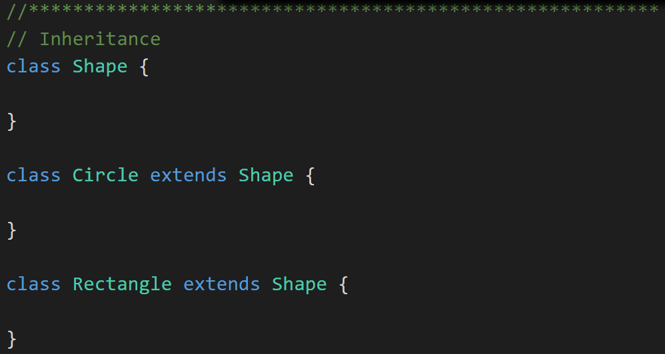
Inheritance
Inheritance: When one Class acquires the Properties and Methods of another Class it is called Inheritance. [link]
Shape
Circle
Rectangle
Square
Notes:
The first of many “Shape” examples. We will get to a Abstraction example in a few minutes.

Slide 21
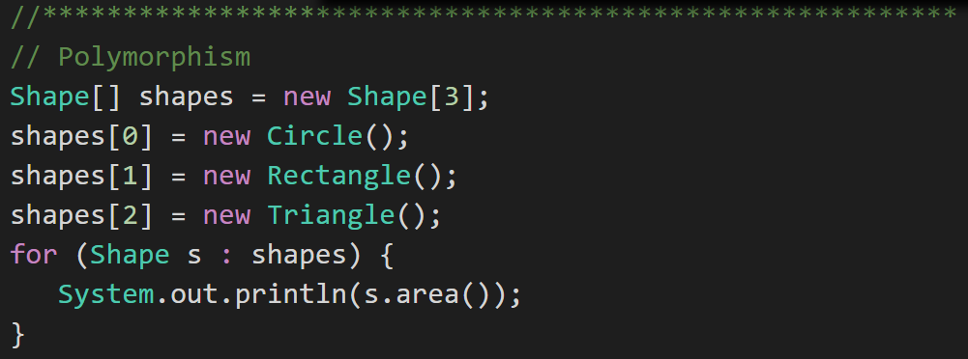
Polymorphism
Polymorphism: Polymorphism enables you to process collections of related things generically. This is particularly useful when you want to use a loop to march through a collection of items. [link]
Notes:
Example of polymorphism: a for loop that moves through the entries of a list. The list might be of a collection of related kinds of object. We can refer to each of the objects in the list through a generic variable (whose data type matches the one that all are ultimately related to). But, when we invoke a particular function that all members of the family share, each will respond by performing that function in their own specific way. For example, we could have a collection of Shape objects. We could refer to each entry in the Shape list through a generic Shape variable, even though the actual entries in the list are specific kinds of shapes – Circle, Rectangle, etc. All Shape objects might have the ability to calculate their own area. When we refer to an object in the list through a generic Shape variable and tell it to calculate its area, thanks to polymorphism, the circle version of the area() function will be called when we’re dealing with a circle, and the Rectangle version of area() will be called when we’re dealing with a rectangle, etc.
The first time through the for loop, we’ll call the Circle.area() function – actually, we won’t; it will happen automatically. The next time through, we’ll call the Rectangle version, and then we’ll call the Triangle version.
Polymorphism is implemented behind the scenes using a Virtual Method Table (VMT). The VMT keeps track of where various related classes’ same-named functions are located in memory. Using the VMT, the operating system is able to figure out which code to implement when we tell each shape to fire its area() function.

Slide 22
More Object-Oriented Programming Concepts
The “Big Three” Concepts:
Encapsulation... and Information Hiding
Inheritance
Polymorphism
Additional Important Object-Oriented Terms:
Abstraction utilizing Abstract Classes or Interfaces
Ownership through Composition & Aggregation

Slide 23
Abstraction
Abstraction: Something is abstract when it is a concept but is not concrete or defined enough to be built. Generally, in OO design, we start with abstract things, and then we build on them through Inheritance. [link]
Abstraction can be implemented through Abstract Classes or by utilizing Interfaces.
Notes:
The first of many “Shape” examples. We will get to a Abstraction example in a few minutes.

Slide 24
Interfaces In Java Preview

Slide 25
And we have and example of Abstraction.
Abstraction
Abstraction is another key concept. Something is abstract when it is a concept but is not concrete or defined enough to actually be built. Generally, in OO design, we start with abstract things, and then we build on them through inheritance.
An abstract class is one that has one or more abstract methods.
An abstract method is a method / function that has no body – just a name, return type, and parameters.
An interface is the strictest interpretation of an abstract class – it is a data structure that consists entirely of abstract methods. In other words, none of its methods/functions have a body.
Abstraction is related to inheritance. Often, when we construct families of related objects, we start the family with an abstract class that represents the least common denominator for everyone in that family. In other words, what do all classes that are part of that family have in common? We often (not always, but often) put that in an abstract class.

Slide 26
Interfaces beyond Java

Slide 27
Interfaces beyond Java
C++
Supports multiple inhertance No formal concept of of Interfaces but support multiple inheritance
Java
Go
Notes:
The first of many “Shape” examples. We will get to a Abstraction example in a few minutes.

Slide 28
End of Session

